Slide 1
City Theater
Out History and Future

Slide 2
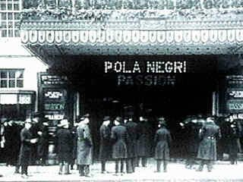
The Beginning
Metro Theater on West Blvd.
  10 years
Grand Metro, same location
  2 years
City Theater on River St.
  Current location

Slide 3
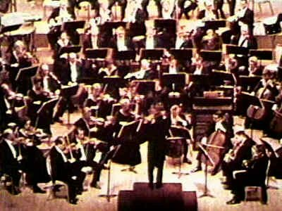
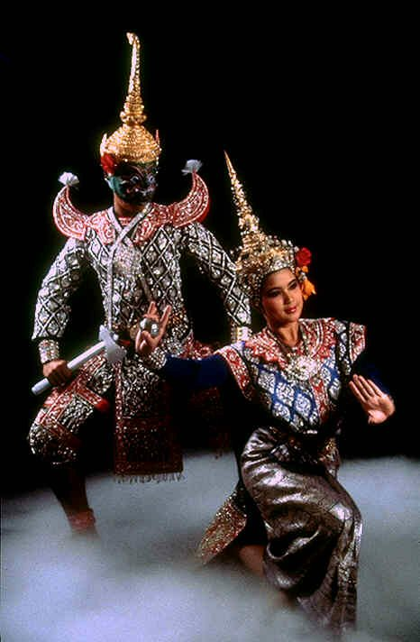
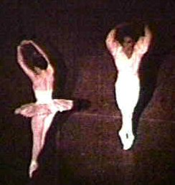
Great Performances
Lodon Philharmonic Orchestra
Bolshoi Ballet
Thai Dancers

Slide 4
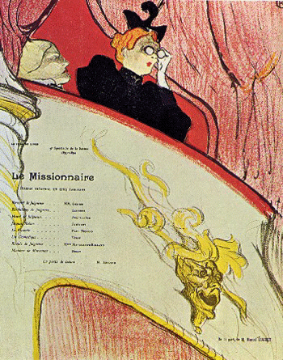
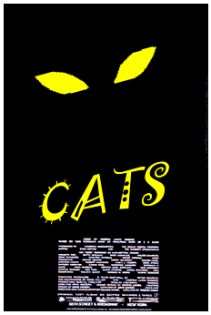
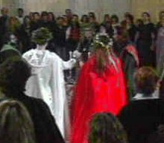
Great Plays
My Fair Lady
Romeo & Juliet
West Side Story
Cats

Slide 5
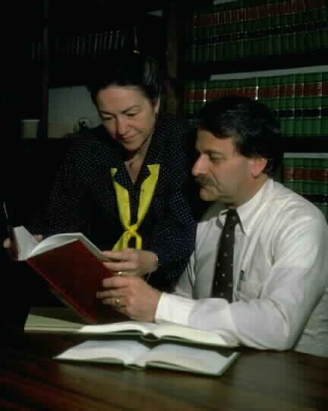

Great Managers
Current:
Albert Sofich, Theater Manager
Gloria Smith, Assistan Manager
Henri Waldenburg, Theater Manager
Helena Mastif, Assistant Manager

Slide 6
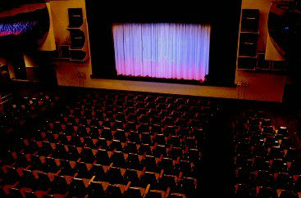
Renovation
Fund-raising success!
Interior renovation
  New seating
  New stage
  New screen for movies

Slide 7
The Future
Exterior renovation
Re-pave parking lot
New sound system
New lighting system
Create web site

